Slide 1
Recognition & Treatment of Exertional Rhabdomyolysis
Great Lakes Athletic Trainers’ Society
March 9, 2023
Sarah Manspeaker, PhD LAT, ATC
Associate Professor, Athletic Training
Duquesne University
Co-created with Kelley Henderson, EdD, LAT, ATC
University of West Florida

Slide 2
No Conflict to Disclose
I, and Duquesne University, have no financial or other associations with the manufacturers of commercial products, suppliers of commercial services, or commercial supporters. This presentation does not involve the unlabeled use of a product or product under investigational use. There was no commercial support for this activity.
The views expressed in these slides are mine. My views may not be the same as the views of my company, clients, or colleagues. Participants must use discretion when using the information contained in this presentation.

Slide 3
At the conclusion of this course, you will be able to:
Differentiate between signs and symptoms of Exertional Rhabdomyolysis and other conditions
Identify current effective intervention(s) for treatment of Exertional Rhabdomyolysis
Identify and incorporate appropriate rehabilitative activities for return to activity
Session Objectives

Slide 4
Overview of the Condition
Exertional Rhabdomyolysis

Slide 5
Exertional Rhabdomyolysis (ER)
Clinical and biochemical syndrome
Skeletal muscle injury destructs muscle cell membrane
Allows release of muscle cell contents into plasma
Breakdown of skeletal muscle tissue induced by exercise
Potentially exacerbated by heat and dehydration
Renal failure
Compartmental syndrome
Abnormalities in heart rhythm
Tremors
Cardiac arrest

Slide 6
ER Background
Incidence of rhabdomyolysis = approximately 26,000 cases per year in the United States
Unknown how many of these cases are due to exertion
10-fold increase from 2000-2009 to 2010 – 2019 (Boden et al, 2021)
Other causes
Best documented in the military population
Intense bouts of physical activity
Likely unacclimated to conditions
Possible overtraining of isolated muscle groups
Incidence in trained and untrained adults and older teens is increasing

Slide 7
Diagnosing Exertional Rhabdomyolysis

Slide 8
Diagnosing ER
Signs and Symptoms
Extreme myalgia(s)
Worse than delayed onset muscle soreness
Weakness
Myoglobinuria*
Normal = 0-149 ng/ml
“Cola” or “Tea” colored urine
ROM deficits
CK level elevation
CK 5x normal –OR-- greater than 10,000 IU·L ⁻¹
Some as low as 5,000 IU·L ⁻¹
Most sensitive lab test
Lab reference interval is 24-173 U/L

Slide 9
Diagnosing ER
Points to Consider
Intense bouts of exercise
Or other historical change
Sickle Cell Trait
Heated environment
Acclimation
Not uncommon to occur in “clusters”
Males
Black athletes
Typically occurs in LE

Slide 10
A Few Cases…
Growing documentation 2010 to present

Slide 11
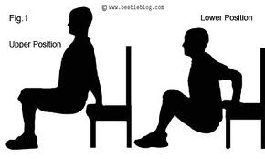
Case Report
Oregon HS football team
Pre-season overnight “immersion” camp
Day 1 of camp
Alternating chair dip/push up, no rest periods
Indoor training facility
22 of 43 players diagnosed with ER
12 were hospitalized
“Cluster”
Oh et al, 2011

Slide 12
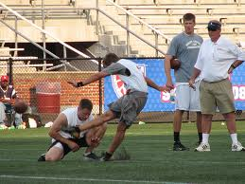
Case Report
D1, 18-year-old
Place kicker
4th week pre-season
10 sets of 30 squats with resistance bands
Followed by Romanian dead lifts and shoulder shrug bicep curls
Hospitalized 8 days
Moeckel-Cole & Clarkson, 2009

Slide 13
Case Report
NSCA stated coaches at this institution,
“misinterpreted the findings of a study
that they claimed supported their use
of the workout to increase strength
during the first days of
off-season conditioning.”
Division I Football
Midwest
First session of off-season workout
Sled pushes and back squats
100 back squats 50% of 1-RM
Allowed rest and as many sets as needed
Over next 3 days 10 players officially diagnosed with ER
Primarily lower extremity
“Cluster”, 9 hospitalized
1 had sickle cell, 2 reported creatine use
Update: University settled for $15, 000 in lawsuit filed by one of the 13 players
Smoot et al, 2013

Slide 14
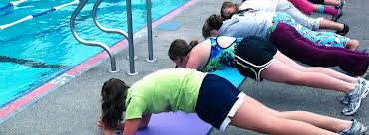
Case Report
D1 swimmers
South Carolina
Day 1 semester workout
Alternating push-ups (1 min) and body-weight squats (1 min), total 10 minutes
Next 2 days were UE strength focused
7 swimmers reported over next 4 days with S/S
“Cluster”
Triceps and pectorals
All hospitalized
Galvez et al, 2008

Slide 15
Case Reports
Texas Women’s University
University of
Oregon
August 2016
8 women’s volleyball players
Pre-season testing
Had to complete a certain amount of reps in a specific time
January 2017
3 football players
Off-season conditioning following winter break
Strength coach suspended

Slide 16
Case Report
During fifth match of the season (81ºF), 2nd consecutive day, c/o:
Cottonmouth, tunnel vision, and cramping in her right biceps
After match, condition deteriorated to:
Multiple muscle cramps
Dizziness
Shivering
Headache
CK Levels 357 IU/L upon admittance to ED and 277 IU/L upon discharge
RTP 6 days later, CK 96 IU/L
Henderson et al, 2019

Slide 17
Predisposing Factors

Slide 18
Known Predisposing Factors
Sickle cell trait
Low oxygen tension lead to sickling
Restricts blood flow/supply (ischemia)
Can lead to breakdown of muscle tissue and rhabdo
Heated environment
Dehydration
Decrease blood flow to muscle
Increase blood flow to skin
Increase cell membrane permeability
Eccentric Contractions
Muscle forced to lengthen
Muscle damage could worsen with dehydration
Early in season/training
More details to come…

Slide 19
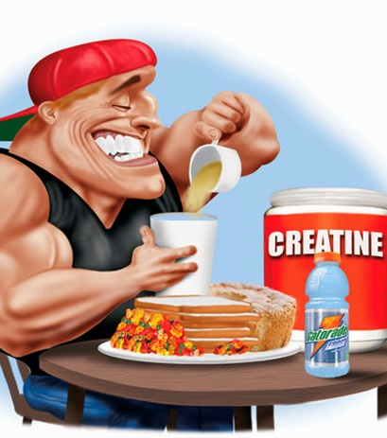
Theorized Predisposing Factors
Recent/previous illness
Influenza
Concussion?
Supplement use
Creatine

Slide 20
Training Considerations

Slide 21
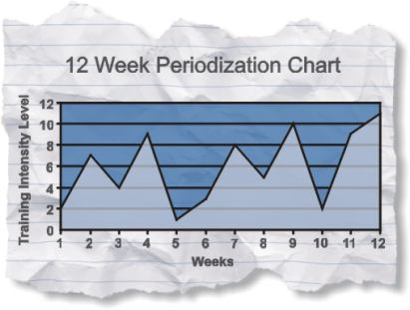
Early Training
First few days
Encourage pre-season participation
Avoid high-rep, repetitive, excessive exercise
New participants particularly
Progress slowly
Build up with paced progressions
Allow rest and recovery

Slide 22
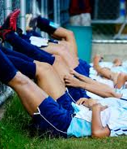
Climate
Ambient temperature should be balanced
Not during excessive heat
Adjust work/rest ratios
Emphasize hydration

Slide 23
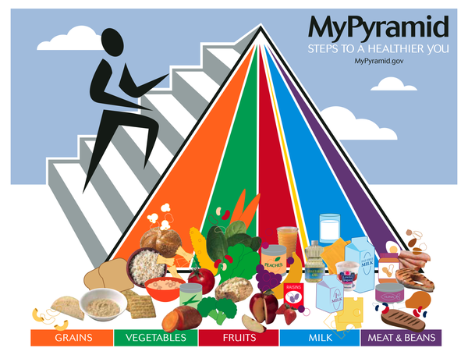
Dietary Adjustments
Not during transition times
Maintain proper nutritional intake

Slide 24
Communication & Documentation
Ensure physical has been conducted
Open communication line with sports medicine staff
Report dark urine post-workout
Report dizziness
Use Patient Reported Outcomes Measures (PROs)

Slide 25
Those with Sickle Cell
Avoid
Early season sprinting
800-1600 m
Hill running
Stadium steps
Intense sustained strength training
Be aware
End of practice
Cease activity if cramping, pain,
swelling, weakness, tenderness or
fatigue
No activity if SC carrier is ill
https://www.cbsnews.com/news/sickle-cell-trait-sidelines-football-player-what-is-it/
Ryan Clark, Pittsburgh Steelers (2011)

Slide 26
Top Risk Factors for ER
Top performing athletes, “push it”
Workouts outside of periodization
New workouts or part of transition
Intense beyond rational consideration
Punishment
Muscle failure based/eccentric
Overemphasis on one muscle group/load
Too little recovery time
Increasing weight without considering conditioning phase
Workout following practice/game
History of exertional heat stroke
Complications from Sickle Cell Trait

Slide 27
Treatment of Exertional Rhabdomyolysis
Analysis of Current Evidence

Slide 28
Treatment of ER--IV Fluid Replacement
Type of IV Fluid Replacement | Amount | Citation
Normal Saline | 200 ml/h 0.9% 1,000 ml 8,000 ml 3 litres in 24 hours 250 ml/hr | Cleary et al, 2011 Cleary et al, 2007 Goubier et al, 2002 Moekel-Cole & Clarkson, 2009
Normal Saline Titrated | 200 ml/h 0.9% 1,000 ml To produce 200-300 mL/hr urine output | Cleary et al, 2011 Smoot et al, 2013
Normal Saline with Sodium Bicarbonate | 500 mL 1 amp/L 150 mL/hr | Gagliano et al, 2009 Moekel-Cole & Clarkson, 2009 Moghtader et al, 1997
Sodium Chloride | 500 mL | Gagliano et al, 2009
Isotonic Saline with Potassium Chloride | 200 mL/h isotonic saline with 20 mEq potassium chloride | Kahanov et al, 2012
Fluid Not Specified | Not available | Felton et al, 2011 Galvez et al, 2008 O’Connor et al, 2008 Oh et al, 2012 Pearcy et al, 2013 Shelmadine et al, 2013

Slide 29
IV Fluid Replacement
Close monitoring in the hospital setting
Goal of preventing acute renal failure
A urinary output goal of 200 mL/h, urine pH >6.5, and plasma pH <7.5 should be achieved
Alkalization of urine
Protect the kidneys
Rapid alleviation of shock (hypovolemia and electrolyte/ acid-base balance)
Hyperkalemia and acidosis
Protection of muscle integrity
Revert/restore contractility to arterioles in injured muscles
Torres et al, 2015; Better et al, 2011

Slide 30
Hospitalization
Citation | n | Number of Days Hospitalized | Number of Days to Return to Activity
Cleary et al, 2007 | 1 | 3 | 7
Cleary et al, 2011 | 1 | 6 | 90
Felton et al, 2011 | 1 | 3 | 14 – no activity 28 – full RTA
Moeckel-Cole & Clarkson, 2009 | 1 | 8 | 30
Pearcey et al, 2013 | 1 | 5 | 30
Smoot et al, 2013 | 13 | Min = 4 Max = 6 Mean = 5 | 14-24

Slide 31
ER Summary of Treatment
Varies by individual
CK values may change/go up in first few days
Continued testing needed
Amount and type of fluid replacement
Must treat early--avoid acute kidney injury (AKI)
AKI most common complication
Morbidity & mortality
McMahon Score (Sn = 86%; Sp 68%)
Predictive of need for high volume fluid resuscitation, renal replacement therapy, and death
Time to recovery
Resolution of s/s
Return to activity
Schleich et al, 2022; Nye et al, 2021

Slide 32
Recovery and RTA Following Exertional Rhabdomyolysis
What is the Evidence?

Slide 33
Assess ER Recurrence Risk
Asplund & O’Connor, 2016

Slide 34
Recommendations for RTA
Continue history monitoring
No muscle p!
No flu like s/s
Normal values
Blood CK
Urine CK
Myoglobin
2-3 days prior
Hydrated

Slide 35
Recommendations for RTA
Mild physical activity
Re-acclimatize
Monitor blood and urine values
Avoid
Extreme environments
Eccentric activity
Downhill walk/running
Weight training
Ensure slow progression

Slide 36
Recommendations for RTA
Reconditioning Program
Monitored by Athletic Trainer
Individualized
Extent of muscle injury
Pre-incident level of fitness
Previous training experience
Especially weight training
Eccentrics
15-weeks recommended (currently!)
Includes general recovery and RTA program

Slide 37
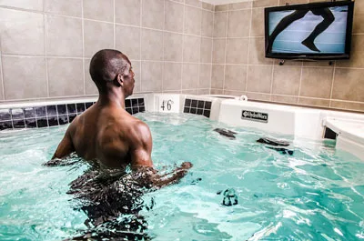
RTA Recommendations
Aquatic therapy
Reduced eccentric load
Gradual increase to land activity
Slow progression to weight training
Use 1-RM as guide

Slide 38
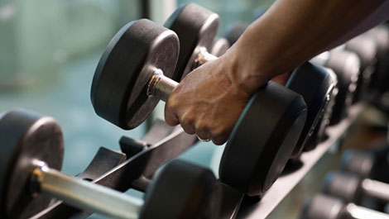
Recommendations for RTA
For weight training
Low intensity
<67% 1-RM
High reps (12-20)
Moderate level
67-75% 1-RM
Low reps (2-8)
Strength-power intensity
75-90% 1-RM
Low reps (2-8)
No increase in muscle soreness!!
In general, perform for two consecutive days
before considering moving to next step.

Slide 39
RTA for Low Risk Individuals
Phase I
72 hours rest and significant hydration 8 hours of sleep per night No heat exposure
At 72 Hours
If CK < 5 x upper limit normal AND urine cleared, ok to go to P2 If CK or urine is abnormal, follow up every 72 hours until clear If CK or urine is abnormal at 2 weeks, seek further evaluation
Phase 2
Begin light activities at own pace and distance (1 week) If no symptoms, move to P3 If symptoms at 4 weeks, seek further evaluation
Phase 3
Gradual return to sport activity Follow up as needed
O’Connor et al, 2008; Asplund & O’Connor, 2016

Slide 40
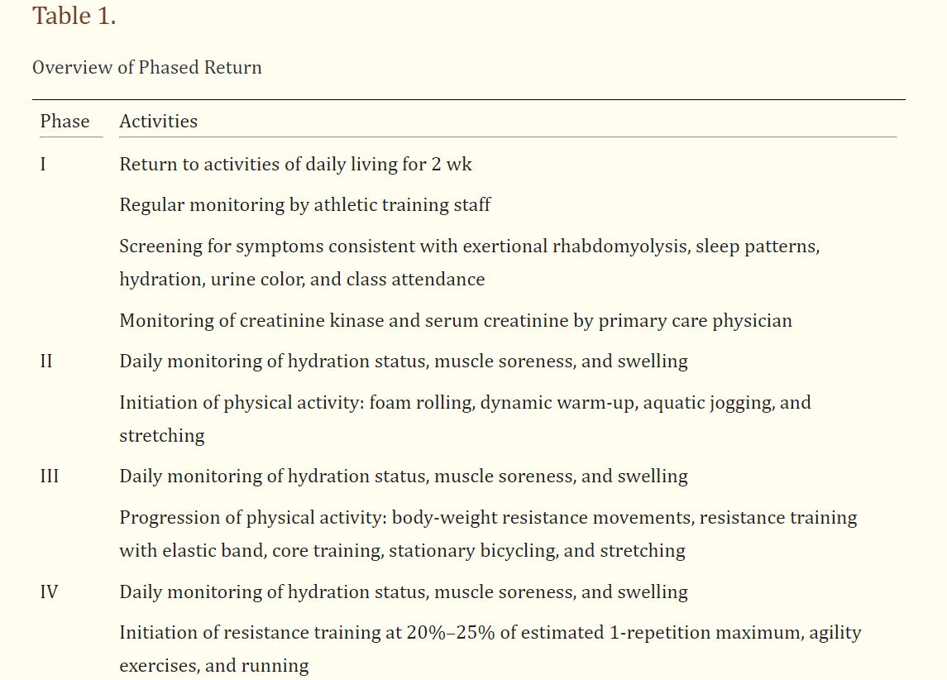
Schleich, Slayman, West, Smoot, 2016

Slide 41
Summary: Important Considerations
Rest Periods
Coaches, strength and conditioning personnel, as well as athletes, need to be aware of and implement
Prevention
Educate these populations
Also educate for early recognition and referral
Sickle Cell Trait
Morbidity outcomes increase when patient is a carrier
Monitor these participants closely
Implement hemodialysis and IV fluid resuscitation early
Return to Activity
Varies greatly by severity
Risk of death
Consider use of PROs for progress
LEFS, DASH, VAS

Slide 42
Summary
Intense bouts of exercise can lead to ER
Clinical Relevance
Be aware of signs and symptoms
Benefit of early recognition, treatment and education on likely course of treatment
Early treatment is a sound course of action
IV saline
Sodium bicarbonate consideration
Future Directions
Is it plausible that higher trained athletes will experience a decreased RTA following ER?

Slide 43
Food for Thought
“Rhabdomyolysis is not an expected or an acceptable outcome of any training program. It is not part of the inherent risk associated with athletic competition...(it) is a sign that (a) training program was inappropriate for…athletes at that time of the year.”

Slide 44
Questions/Comments
Sarah Manspeaker
manspeakers@duq.edu

Slide 45
Sources
Manspeaker SA, Henderson KD, Riddle JD. Exertional Rhabdomyolysis among athletes: a systematic review protocol. Joanna Briggs Institute Database of Systematic Reviews and Implementation Reports. 2014;12(3):112-120.
Nye NS, Kasper K, Madsen CM, Szczepanik M, et al. Clinical Practice Guidelines for Exertional Rhabdomyolysis: A Military Medicine Perspective. Current Sports Medicine Reports 20(3):p 169-178, March 2021. | DOI: 10.1249/JSR.0000000000000822\
Kodadek L, Carmichael II, Seshadri A, et al. Rhabdomyolysis: An America Association for the Surgery of Trauma Critical Care Committee Clinical Consensus Document. Trauma Surgery & Acute Care Open. 2022;7:e000836.
Kim J, Jeong JY, Kim D. Return to play for Exertional Rhabdomyolsysis in Korea National rugby player. International Journal of Athletic Therapy & Training. 2021;27(1):20-24.
Schleich K, Slayman T, West D, Smoot K. Return to play after Exertional Rhabdomyolysis. J Athl Train. 2016;51(5):406-409.

Slide 46
Additional References
Asplund CA, O’Connor FG. Challenging return to play decisions: Heat stroke, exertional rhabdomyolysis, and exertional collapse associated with sickle cell trait. Sports Health. 2015; 8(2): 117-125.
Butcher GM. Sickle cell trait and exertional rhabdomyolysis. Athl Ther Today. 2003; 8(5): 66-67.
Clarkson PM. Exertional rhabdomyolysis and acute renal failure in marathon runners. Sports Med. 2007; 37 (4-5):361-363.
Cleary MA, Sadowski KA, Lee SY-C, Miller GL, Nichols AW. Exertional rhabdomyolysis in an adolescent athlete during preseason conditioning: a perfect storm. J Strength Cond 2011;25(12): 3506–13.
Cleary MA, Ruiz D, Eberman L, Mitchell I, Binkley, H. Dehydration, cramping, and exertional rhabdomyolysis: a case report with suggestions for recover. J Sport Rehabil 2007;16: 244-259.
Felton SD, Heinemann D, Craddock, J. Exertional rhabdomyolysis in a high school athlete. Athletic Training and Sports Health Care 2011;3(5): 230-4.
Gagliano M, Corona D, Giuffrida G, Giaquinta A, Tallarita T, Zerbo D, et al. Low intensity body building exercise induced rhabdomyolysis: a case report. Cases Journal 2009;2(7):
Galvez R, Stacy J, Howley A. Exertional rhabdomyolysis in seven Division I swimming athletes. Clin J Sport Med 2008;18: 366-8.
Goubier JN, Hoffman OS, Oberlin C. Exertion induced rhabdomyolysis of the long head of the triceps. Br J Sports Med 2002; 36: 150-1
Graves EJ, Gillum BS. Detailed diagnoses and procedures, National Hospital Discharge Survey, 1995. National Center for Health Statistics. Vital Health Stat. 13(130). 1997.
Henderson KD, Manspeaker SA, Stubblefield Z. Exertional rhabdomyolysis in a women’s tennis athlete: A case report. IJATT. 2019;24(4):156-9.

Slide 47
Additional References
Kahanov L, Ebermann LE, Wasik M, Alvey T. Exertional rhabdomyolysis in a collegiate American football player after preventative cold water immersion: a case report. J Athl Train 2012;47(2): 228-232.
Moeckel-Cole SA, Clarkson PM. Rhabdomyolysis in a collegiate football player. J Strength Cond Res 2009;23(4): 1055-9.
Moghtader J, Brady WJ, Bonadio W. Exertioanl rhabdomyolysis in an adolescent athlete. Pediatr Emerg Care 1997;13(6): 382-5.
Muldoon S, Deuster P, Voelkel M, Capacchione J, Bunger R. Exertional heat illness, exertional rhabdomyolysis, and malignant hyperthermia: is there a link? Curr Sports Med Rep. 2008; 7(2): 74-80.
Oh JY, Laidler M, Fiala SC, Hedberg K. Acute exertional rhabdomyolysis and triceps compartment syndrome during a high school football camp. Sports Health 2012; 4(1): 57-62.
Pearcey GEP, Bradbury-Squires DJ, Power KE, Behm DG, Button DC. Exertional rhabdomyolysis in an acutely detrained athlete/exercise physiology professor. Clin J Sport Med 2013; 0: 1-3.
Poels PJE, Gabreëls FJM. Rhabdomyolysis: a review of the literature. Clin Neurol Neurosurg. 1993; 95:175-192.
Shelmadine BD, Baltensperger A, Wilson RL, Bowden RG. Rhabdomyolysis and acute renal failure in a sickle cell trait athlete: a case study. Clin J Sport Med 2013; 23(3): 235-7.
Smoot MK, Amendola A, Cramer E, Doyle C, Kregel KC, Chiang H, et al. A cluster of exertional rhabdomyolysis affecting a Division I football team. Clin J Sport Med 2013; 23(5): 365-372.
Thompson TL, Nguyen TX, Karodeh CR. Twelve cases of exertional rhabdomyolysis in college football players from the same institution over a 23-year span: a descriptive study. Phys Sportsmed, 2018; 46(3): 331-334.
Stark et al. Battlefield pain summit 2022: Expert consensus statements. J Trauma Acute Care Surgery. 2022;93(2S): p:12-15.

